Slide 1
Preservice Mathematics Teachers’ Attitudes towards Using a Blogging Activity in a College Euclidean Geometry Class
GSA Presentation Competition
Presented by:
Md. Mokter Hossain
Doctoral Candidate in Math Education College of Education
University of Nevada, Reno
April 17, 2012

Slide 2
Preservice Mathematics Teachers’ Attitudes towards Using a Blogging Activity in a College Euclidean Geometry Class
Purpose of the Study
Examining Preservice Mathematics Teachers’ Attitudes toward using a Blogging Activity in a College Euclidean Geometry Class
Background of the Study
Technology in the NCTM Principles and Standards
Technology as an aid to enhance T-L math
Current progress in STEM education in the U.S.
Technology in the math education programs

Slide 3
Preservice Mathematics Teachers’ Attitudes towards Using a Blogging Activity in a College Euclidean Geometry Class
Statement of the Problem
Rapid growth of the Internet and mobile web usage
Web 2.0 for improving mathematics education
A timely and appropriate research
Blog, is an appropriate Web 2.0 application
The results may provide important information for policy-makers and instructional designers

Slide 4
Preservice Mathematics Teachers’ Attitudes towards Using a Blogging Activity in a College Euclidean Geometry Class
Purpose of the Study
Attitudes vs gender
Attitudes vs Self-reported time on the Internet
Advantages and Disadvantages of using blog
Recommendation for blog and other Web 2.0 apps

Slide 5
Preservice Mathematics Teachers’ Attitudes towards Using a Blogging Activity in a College Euclidean Geometry Class
Significance of the Study
Use of Blog as an alternative teaching-learning tool
Perceptions in both teaching and learning perspectives
Find a way to utilize U.S. students’ leisure time
Building collaborative T-L environment
Findings could be a milestone for math education

Slide 6
Preservice Mathematics Teachers’ Attitudes towards Using a Blogging Activity in a College Euclidean Geometry Class
Research Questions
Quantitative Research Questions
RQ1. Are there significant differences by gender with regard to preservice mathematics teachers’ attitudes toward the blogging activity?
RQ2. Do preservice teachers who report spending more time on the Internet differ significantly from those who report spending less time on the Internet with regard to their attitudes toward the blogging activity?

Slide 7
Preservice Mathematics Teachers’ Attitudes towards Using a Blogging Activity in a College Euclidean Geometry Class
Research Questions
Qualitative Research Questions
RQ3. What do preservice secondary mathematics teachers perceive as the advantages and disadvantages of using a blog as a supportive tool in a Euclidean Geometry course?
RQ4. What do preservice secondary mathematics teachers recommend of using blog and other Web 2.0 Technologies in the future classes they will be taking/teaching?

Slide 8
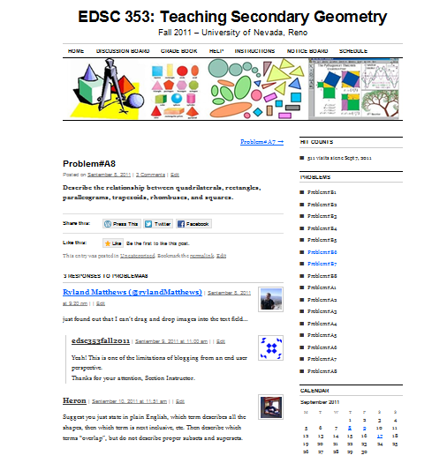
Preservice Mathematics Teachers’ Attitudes towards Using a Blogging Activity in a College Euclidean Geometry Class
The Blogging Activity and Selection of Participants

Slide 9
Preservice Mathematics Teachers’ Attitudes towards Using a Blogging Activity in a College Euclidean Geometry Class
Instrumentation and Data Collection
A researcher developed anonymous survey
Quantitative data from a number of Likert scale questions, and students’ in-class quiz scores
Qualitative data from two open-ended questions of the survey, and students’ discussion on the blog
A mixed-methods research design will be utilized

Slide 10
Preservice Mathematics Teachers’ Attitudes towards Using a Blogging Activity in a College Euclidean Geometry Class
Reliability and Validity Checking
Validity of the Instrument was examined by Five experts who have long time experience in teaching and Research in Mathematics Education
Reliability of the Instrument was measured by using both split-half and Cronbach's alpha methods with both SPSS-PASW for Windows and Reliability Calculator developed by Siegle (2002); and an EXCELLENT Reliability (Alpha >.9).

Slide 11
Preservice Mathematics Teachers’ Attitudes towards Using a Blogging Activity in a College Euclidean Geometry Class
Results and Discussion
Results of the Quantitative RQ-1
RQ1: U test with GENDER and ATTDONBLOGGING

Slide 12
Preservice Mathematics Teachers’ Attitudes towards Using a Blogging Activity in a College Euclidean Geometry Class
Results and Discussion…
Results of RQ-2
U test with TIMEONINTERNET and ATTDONBLOGGING

Slide 13
Preservice Mathematics Teachers’ Attitudes towards Using a Blogging Activity in a College Euclidean Geometry Class
Results and Discussion…
Results of RQ3:
Advantages and disadvantages of using a blog as a supportive tool in a Euclidean Geometry course

Slide 14
Preservice Mathematics Teachers’ Attitudes towards Using a Blogging Activity in a College Euclidean Geometry Class
Results and Discussion…
Results of RQ4: Preservice secondary mathematics teachers recommend of using blog and other Web 2.0 Technologies in the future classes they will be taking/teaching

Slide 15
Preservice Mathematics Teachers’ Attitudes towards Using a Blogging Activity in a College Euclidean Geometry Class
References
Cash, J. C. (2010). Web 2.0 and self-reported student performance among high school students in rural schools. (Doctoral Dissertation. UMI #3416273), The University of Southern Mississippi, Mississippi - United States.
National Council of Teachers of Mathematics (NCTM). (2000). Principles and Standards for School Mathematics. Reston, VA: Author.
Reilly, E. M. (2007). Writing to Learn Mathematics: A mixed method study. (Doctoral Dissertation). Retrieved October 3, 2011 from, http://dspace.lib.iup.edu:8080/dspace/bitstream/2069/61/1/Edel+Reilly.pdf
Siegle, D. (2002). Reliability. Retrieved October 4, 2011, from http://www.gifted.uconn.edu/siegle/research/Instrument%20Reliability%20and%20Validity/Reliability.htm

Slide 16

Thank You Very Much
Preservice Mathematics Teachers’ Attitudes towards Using a Blogging Activity in a College Euclidean Geometry Class

